Slide 1
Global Interdependence
Ch 36

Slide 2
How has science and technology change people’s lives in the last 50 years?

Slide 3
Communication
Since the early 1960s, satellites have aided worldwide communication and the world is gradually being changed into a global village
This linking of the globe has been made possible by the miniaturization of the computer
Starting in the 1990s, businesses and individuals began using the internet
Between 1995 and 2002, the number of internet users around the world increased from 25 million to 600 million

Slide 4
Green Revolution
Green Revolution- movement to increase agricultural production starting in the 1960s
Scientists used chemical fertilizers, pesticides, and high-yield, disease resistant strains of crops to increase productivity
The green revolution helped avert famine in many areas of the world, particularly in India
The biggest negative effect of the green revolution is environmental pollution from chemicals

Slide 5
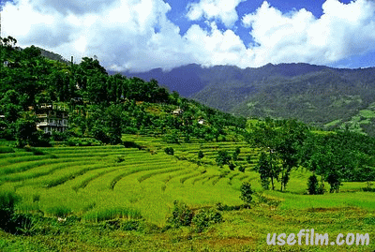

Slide 6
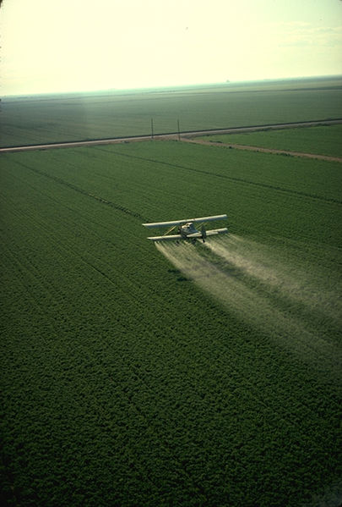

Slide 7
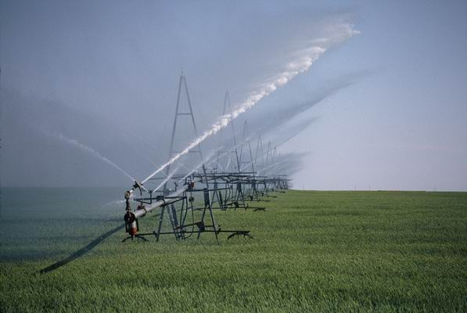

Slide 8
What are the effects of the Green Revolution?

Slide 9
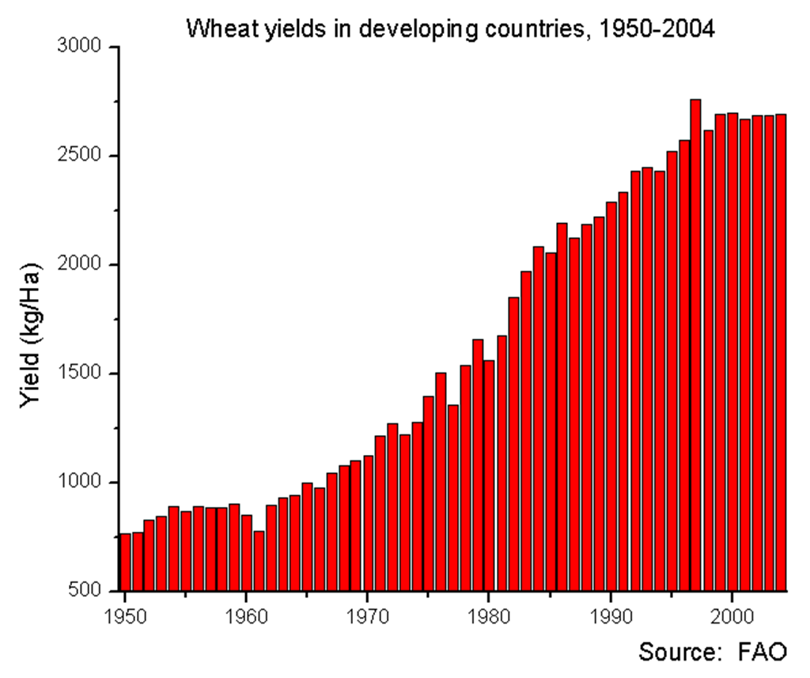

Slide 10
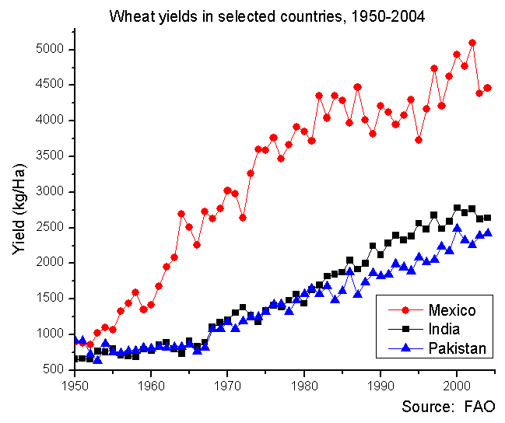

Slide 11
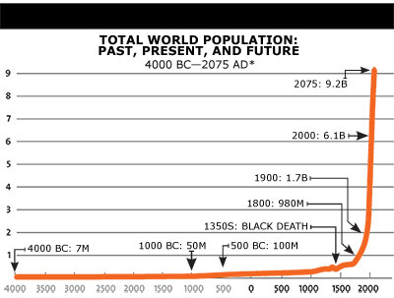

Slide 12
Economic Globalization
Economies around the world have been linked for thousands of years through trade but the true the true global economy did not start until the late 1800s
Multinational corporations such as Ford, Exxon, Toyota have established manufacturing plants, offices, or stores around the world

Slide 13
What is a tariff?

Slide 14
Free Trade
A major goal of globalization is free trade, or the elimination of trade barriers such as tariffs
The European Union (EU) is an organization of 27 Western European countries that allows free trade between its nations
NAFTA- North American Free Trade Agreement- eliminated tariffs and trade restrictions between Canada, the US, and Mexico

Slide 15
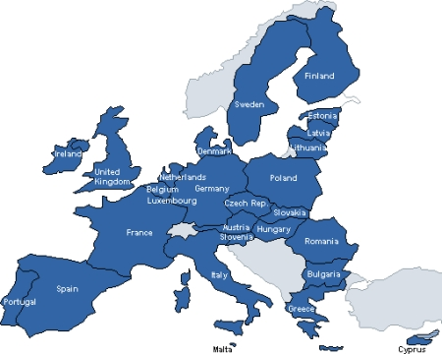

Slide 16
Where does our electricity come from?

Slide 17
Impact of Globalization
Increase in standard of living
Developed nations benefit more than others

Slide 18
Impact of Global Development
The processing of raw materials and transportation of goods requires the use of much energy
Most of this energy comes from oil
OPEC- Organization of Petroleum Exporting Countries- powerful union of oil producing countries mostly in the Middle East

Slide 19
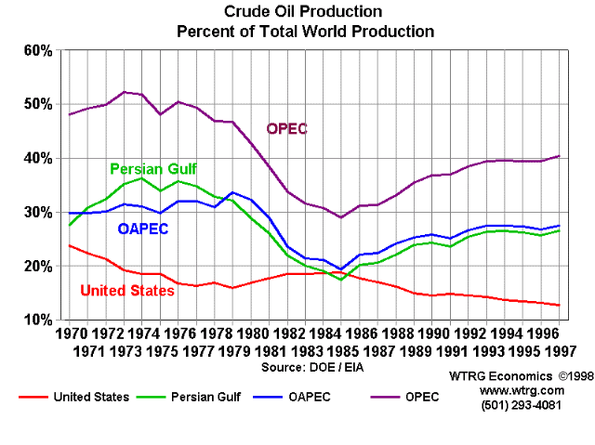

Slide 20
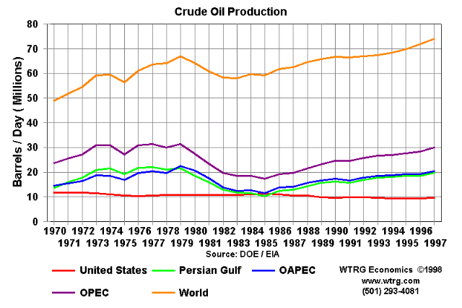

Slide 21
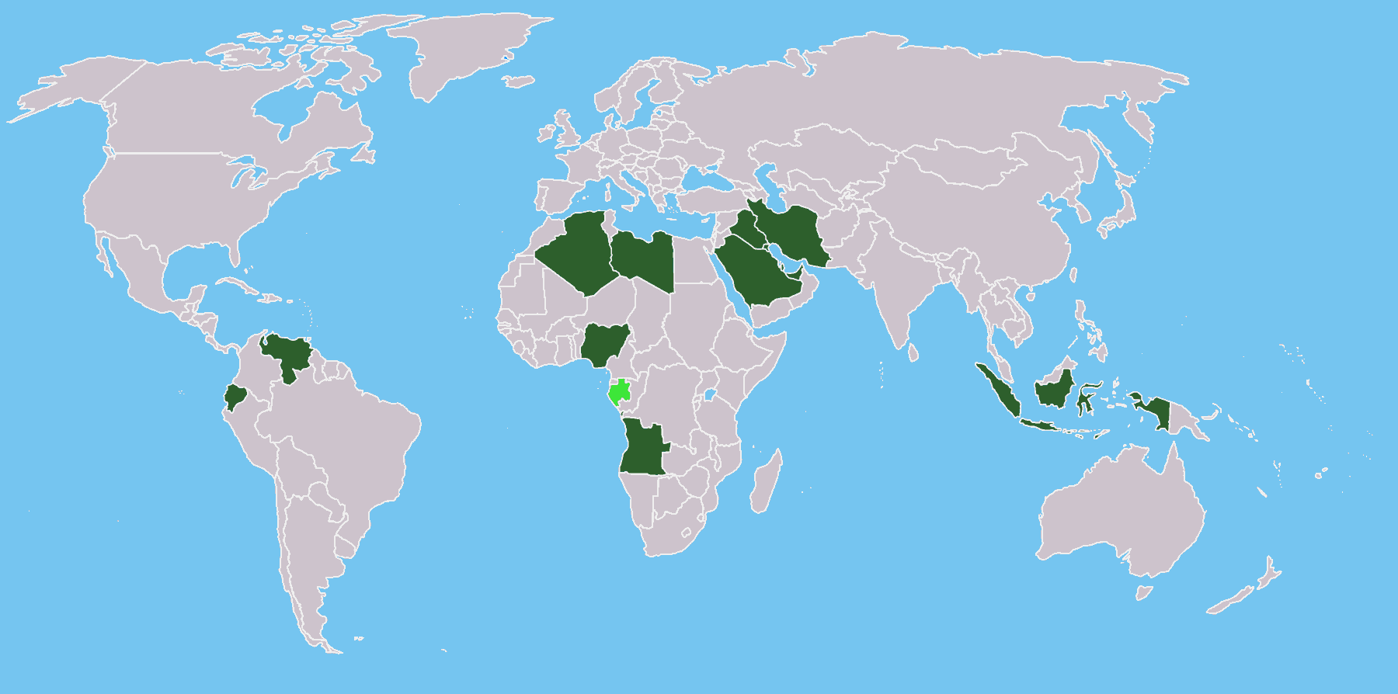

Slide 22
Environmental Impact
The burning of oil and coal releases carbon dioxide into the atmosphere, causing air pollution and acid rain
Some scientists also believe this leads to global warming
The use of CFCs used in refrigerators and air conditioners has destroyed ozone in earth’s atmosphere
The ozone layer is our main protection from harmful UV rays
This damage has caused the incidence of skin cancer to rise and may result in damage to plants and plankton that are the bases of the food chains

Slide 23
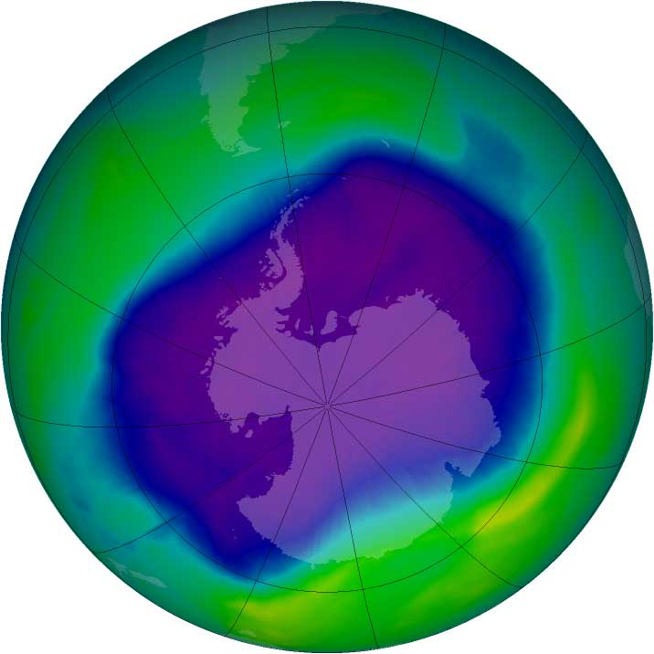

Slide 24
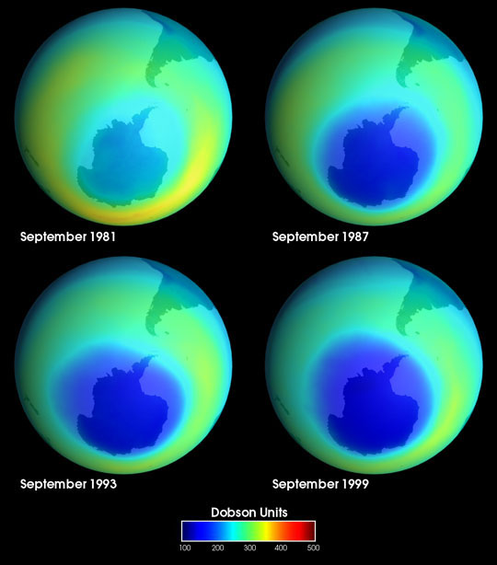

Slide 25
Rainforest
The destruction of the rainforest in developing nations has also been a huge environmental problem
Inefficient slash-and-burn techniques have caused great damage to rainforests in Latin American countries such as Brazil

Slide 26
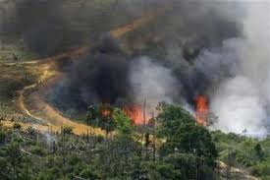

Slide 28
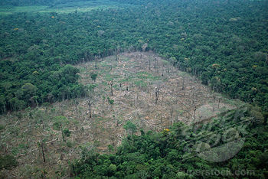

Slide 29
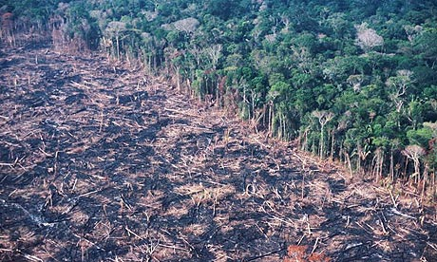

Slide 30
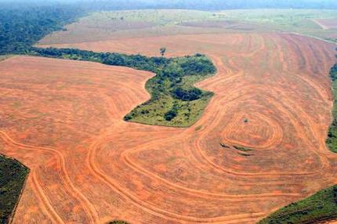

Slide 31
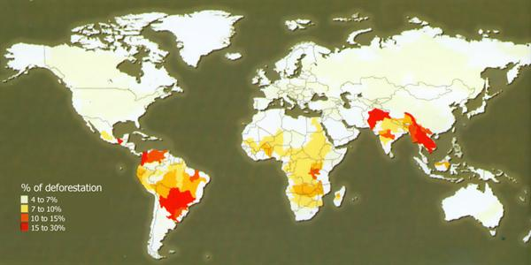

Slide 32
What are the effects of rainforest destruction?

Slide 33
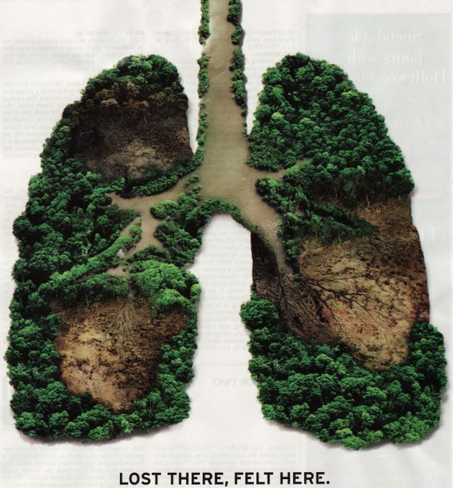

Slide 34
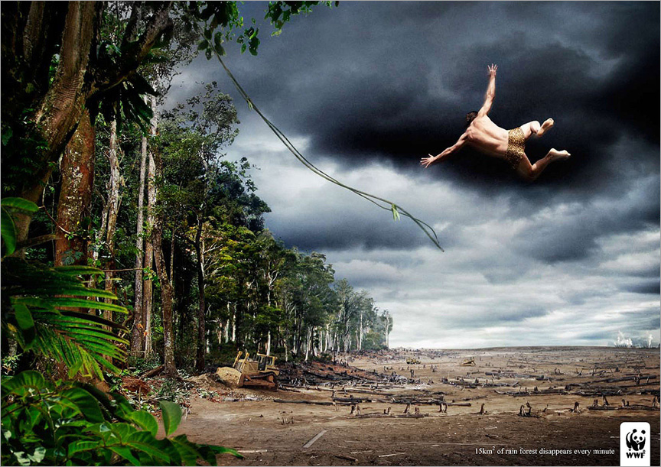

Slide 35
Global Security
Collective security- alliances of countries created with the purpose of keeping the peace such as NATO and the UN
WMDs- weapons of mass destruction, reason the US invaded Iraq in 2003

Slide 36
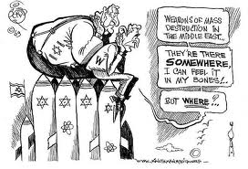

Slide 37
Ethnic and Religious Conflicts
Arabs and Israelis in the Middle East
Serbians, Croats, and Bosnians in former Yugoslavia
Protestants and Catholics in Northern Ireland
Kurds in Turkey
Hutus and Tutsis in Rwanda

Slide 38
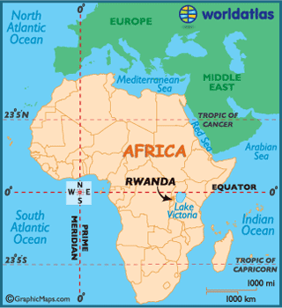

Slide 39
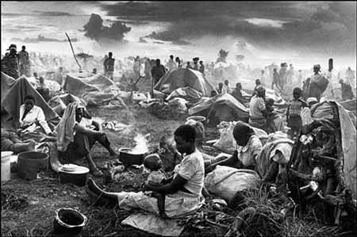

Slide 40
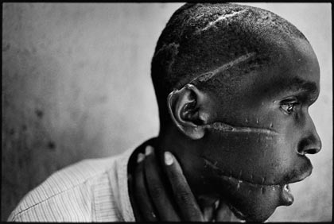

Slide 41
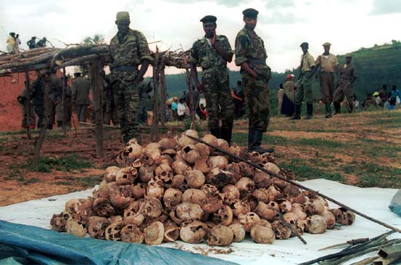

Slide 42
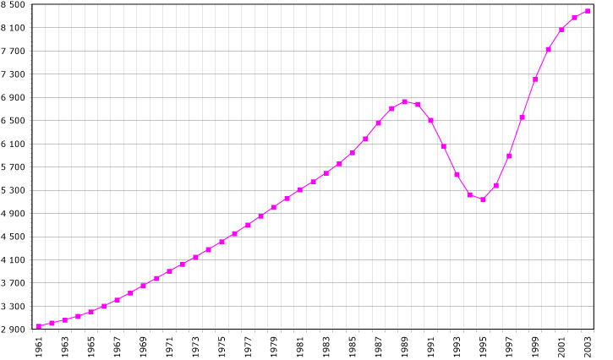

Slide 43
Human Rights
Universal Declaration of Human Rights- statement issued by the UN, “all human beings are born free and equal in dignity and rights”
Mother Teresa- great champion for human rights

Slide 45
Health Issues
AIDS- one of the greatest global health issue
40 million people with AIDS in 2007, mostly in Africa

Slide 46
Terrorism
Terrorism- use of violence against people or property to force changes in society or governments
Since the 1960s more than 14000 terrorist attacks have occurred around the world

Slide 47
Gas attack in Tokyo 1995

Slide 48
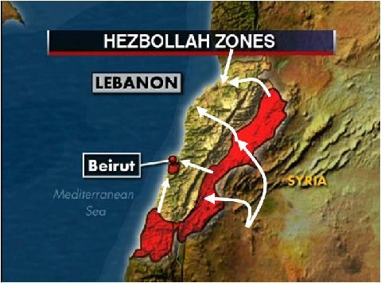
Hezbollah

Slide 49
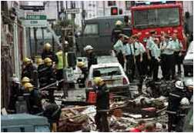
IRA

Slide 50
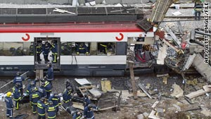
Train Station in Spain

Slide 51
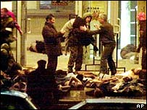
Moscow Theater

Slide 52
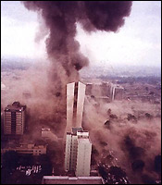
Embassy in Kenya

Slide 53
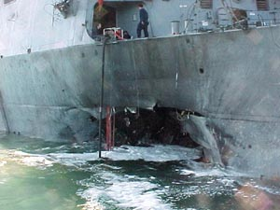
USS Cole

Slide 54
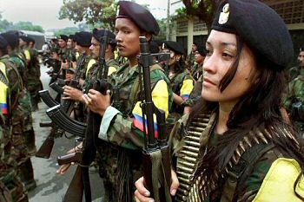
FARC

Slide 55
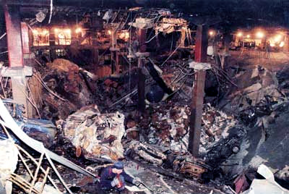
1993 World Trade Center

Slide 56
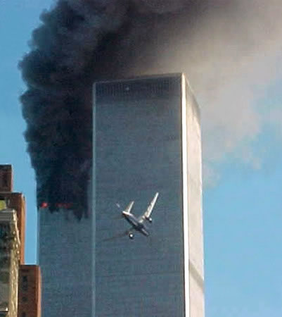
9/11

Slide 57
Blend of Cultures
Mass Media- 99% of US homes have at least one TV

